Slide 1


GoodCabs
GOODCABS
OPTIMIZING OPERATIONS THROUGH DATA-DRIVEN INSIGHTS

Slide 2
GoodCabs
Outline
About
Problem Statement
Dashboard as Solution
Dashboard Screens
Analysis
Recommendations

Slide 3

GoodCabs
About Us
About Company
About Service
Founded two years ago, Goodcabs has expanded its reach across 10 tier-2 cities in India. Our mission is to deliver reliable, affordable rides while creating sustainable opportunities for local drivers, contributing to growth and community welfare.
Goodcabs offers safe, convenient, and affordable rides across multiple cities. Our services include both individual and shared rides, with a focus on passenger satisfaction and reliability, making transportation accessible and efficient for all.
Goodcabs is a rapidly growing cab service provider focused on tier-2 cities in India. We aim to improve local transportation by offering reliable, affordable rides while supporting the livelihoods of local drivers.

Slide 4
GoodCabs
Problem Statement
Lack of actionable insights to monitor and optimize operations across cities.
Challenges in balancing new vs. repeat passengers and improving passenger satisfaction.
Difficulty in tracking performance against monthly revenue and trip targets.
Limited understanding of city-specific trends and demands.
Inconsistent performance metrics across different cities, impacting growth and operational efficiency.

Slide 5
GoodCabs
Dashboard as Solution
The Goodcabs Dashboard provides a comprehensive solution to address the operational challenges:
Overview Page: Summarizes key metrics (revenue, trips, ratings) and city performance.
Revenue Page: Tracks revenue trends, city contributions, and passenger rates.
Trips Page: Provides detailed trip statistics and trends.
Actual vs Target Page: Compares performance against set targets.

Slide 6
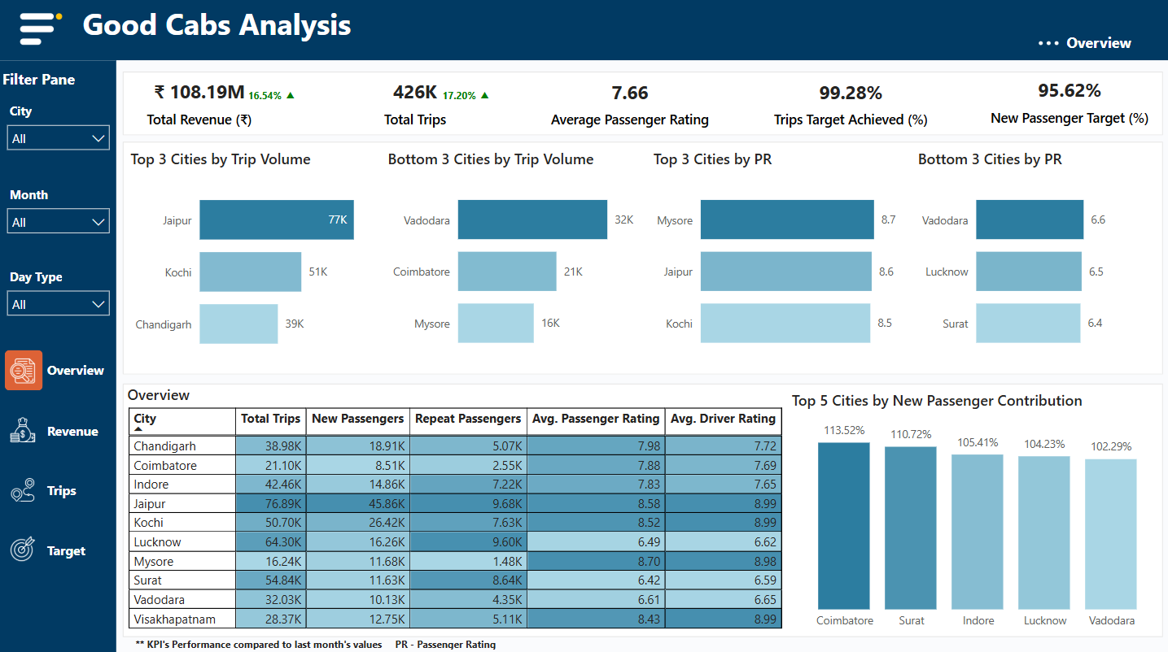
GoodCabs

Slide 7
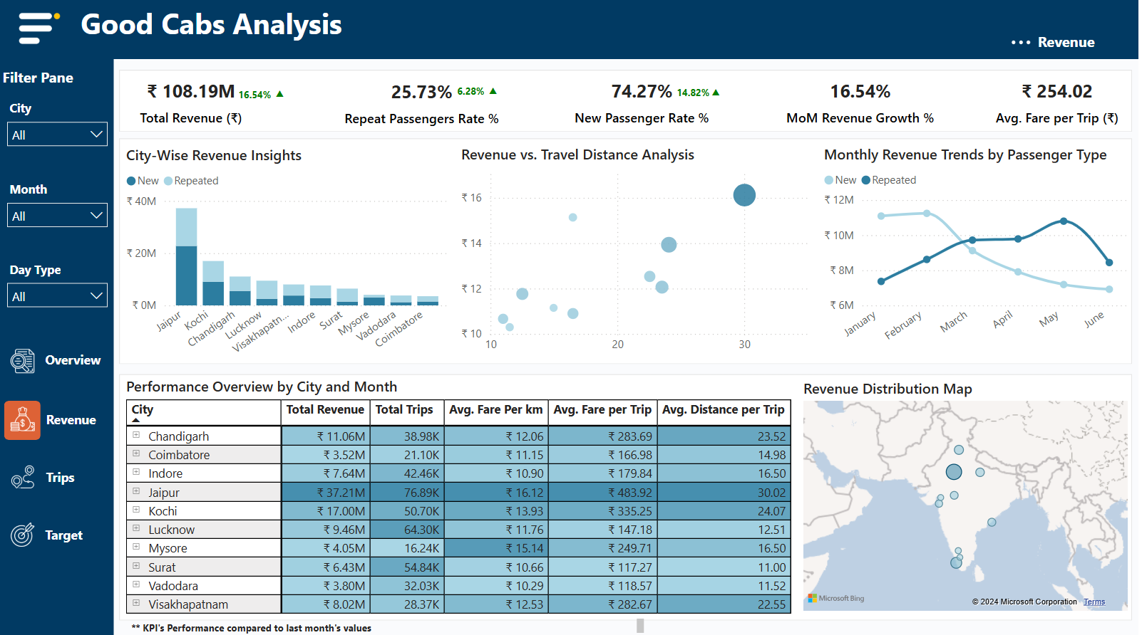
GoodCabs

Slide 8
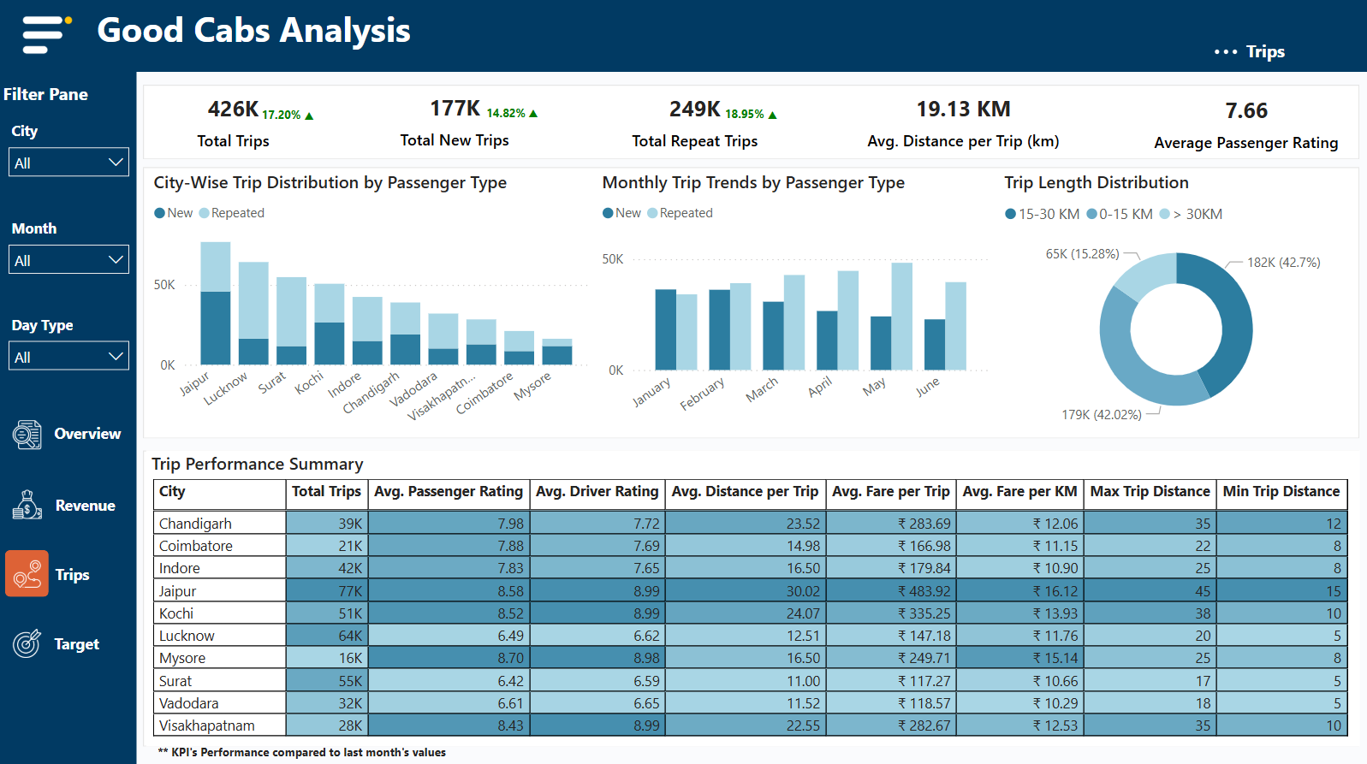
GoodCabs

Slide 9
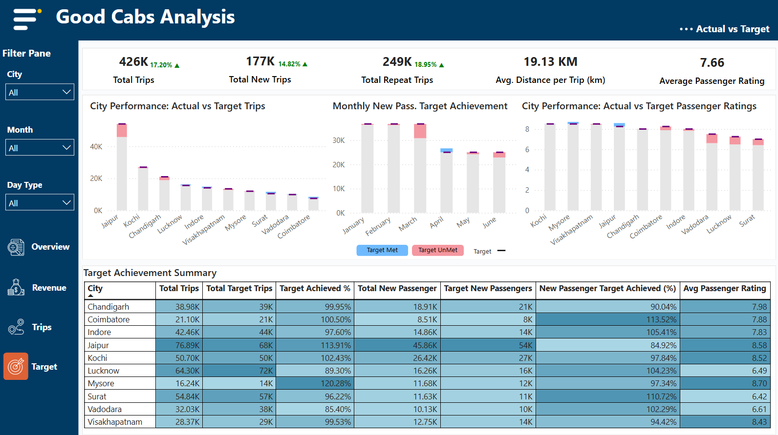
GoodCabs

Slide 10
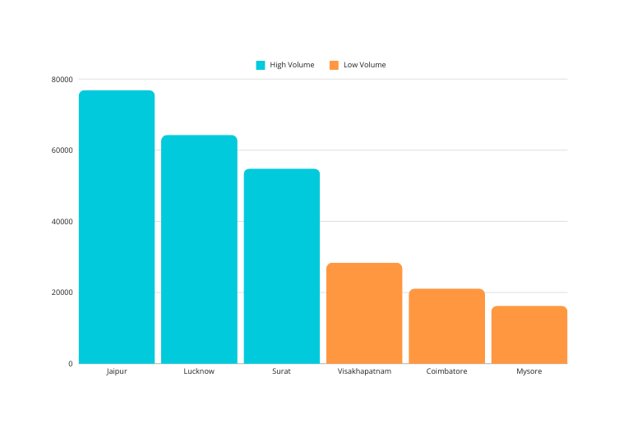
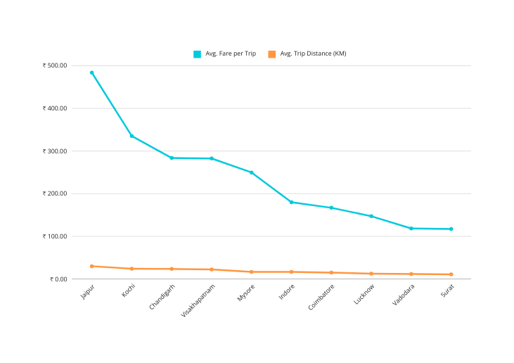
GoodCabs
Revenue & Trips
Top Cities vs. Bottom Cities (Trips)
Analysis
High Revenue Cities: Jaipur generates the highest revenue with an average fare of ₹483.92 per trip.
Low Revenue Cities: Surat has the lowest average fare per trip at ₹117.27.
Trip Volumes: Jaipur, Lucknow, and Surat see the highest trip volumes, while Mysore, Coimbatore, and Visakhapatnam have the lowest.
Seasonal Trends: Jaipur peaked in February, while Mysore and Chandigarh faced low demand in January and April, respectively.
Average Fare vs. Average Distance Traveled (City-Wise)
Recommendations
Enhance demand in low-revenue cities with focused marketing campaigns.
Optimize fares in high-performing cities through premium or dynamic pricing models.
Launch promotions to increase trip volumes in cities like Mysore and Coimbatore.
Learn More

Slide 11
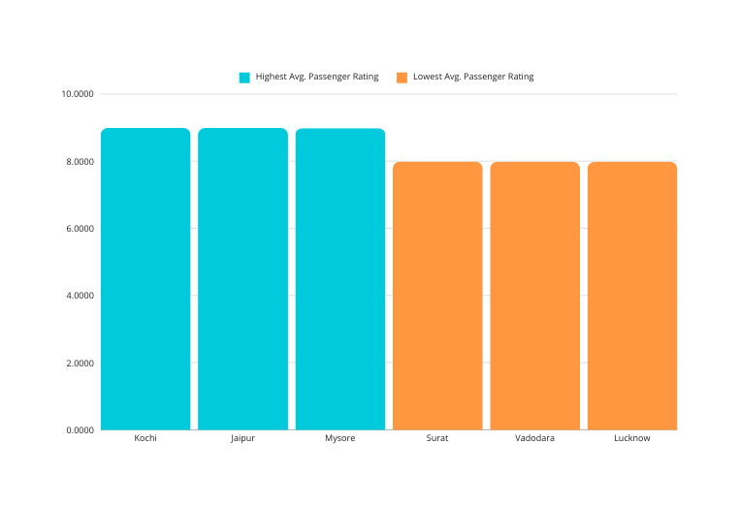
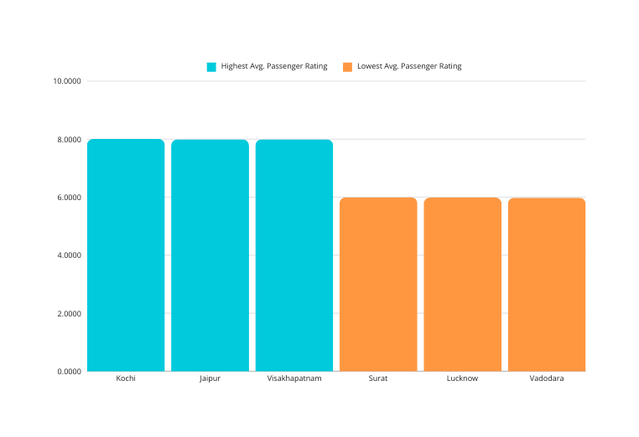
GoodCabs
Passenger Satisfaction
New Passenger Satisfaction: City-wise Average Ratings
Analysis
Top Ratings: Kochi leads with the highest ratings from new passengers (8.99) and repeat passengers (8.00).
Low Ratings: Lucknow trails with a new passenger rating of 7.98 and a repeat passenger rating of 5.99, while Vadodara also shows low ratings, with new passengers at 7.98 and repeat passengers at 5.98.
The ratings in Kochi, Mysore, and Jaipur are relatively similar, indicating consistent passenger satisfaction across these locations.
Weekday vs. Weekend Trends: Mysore and Jaipur experience more demand on weekends, while Lucknow and Vadodara see a preference for weekdays.
Repeat Passenger Satisfaction: City-wise Average Ratings
Recommendations
Implement driver training programs in cities with low ratings, such as Surat, to enhance service quality.
Develop weekend-specific promotions for tourism-driven cities like Mysore and Jaipur.
Offer tailored weekday services in business-focused cities like Lucknow and Vadodara to attract office commuters.
Learn More

Slide 12
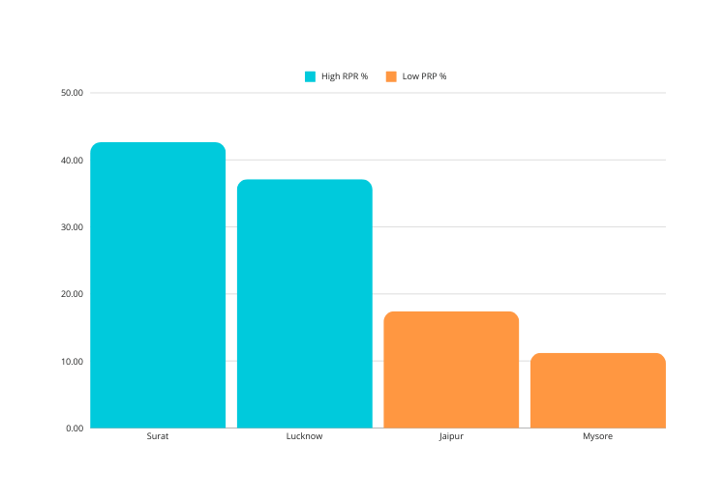
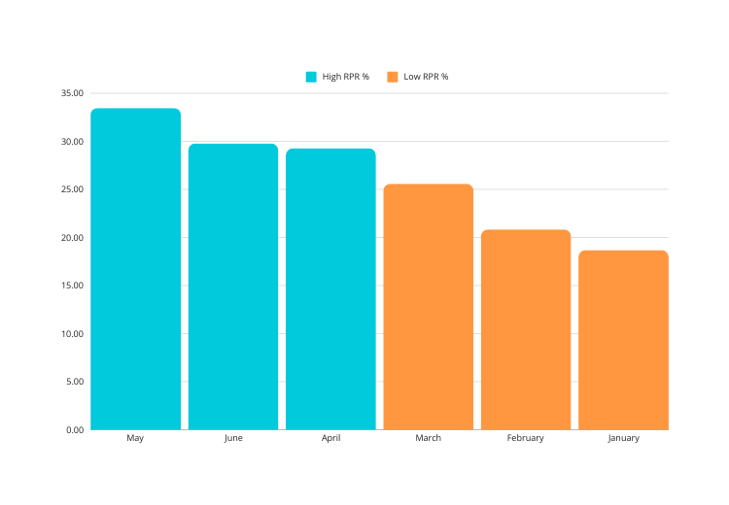
GoodCabs
Repeat Passenger Rate (RPR%)
Repeat Passenger Rate %: City-wise (Top 2 and Bottom 2)
Analysis
Top Cities by RPR: Surat (42.63%) and Lucknow (37.12%) have the highest repeat passenger rates, showing strong customer retention.
Low RPR Cities: Mysore (11.23%) and Coimbatore (25.57%) face challenges in retaining passengers, with lower repeat passenger rates.
City Contribution: Jaipur and Lucknow contribute significantly to the overall repeat passenger base, highlighting their importance in customer retention.
Recommendations
Repeat Passenger Rate %: Month-wise
Introduce loyalty programs in cities with low RPR like Mysore and Coimbatore to improve retention.
Offer exclusive discounts or personalized rewards to repeat customers in top-performing cities like Surat and Lucknow.
Analyze feedback from repeat passengers in low-RPR cities to identify and address pain points, improving customer experience and retention.
Learn More

Slide 13
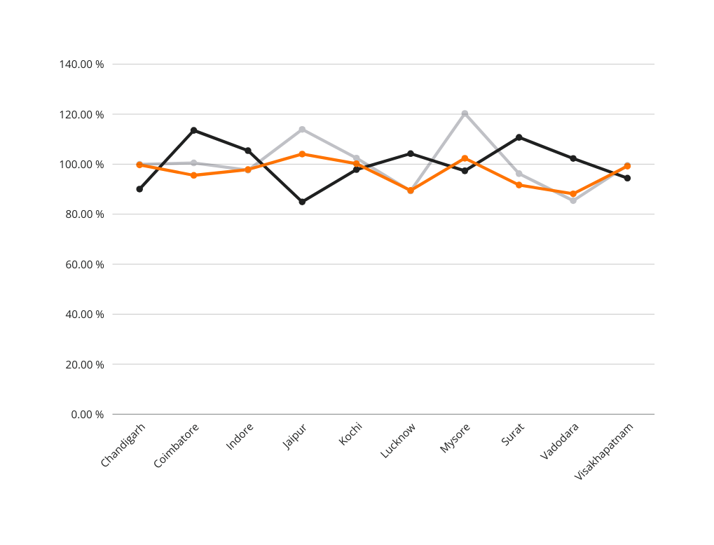
GoodCabs
City Performance Overview
Target Achievement Trends
Analysis
Trip Targets
Mysore exceeded its target by 20.28%, completing 16,238 trips (target: 13,500).
Jaipur surpassed its target with 113.91%, completing 76,888 trips (target: 67,500).
Surat (96.22%) and Vadodara (85.4%) underperformed against their trip targets.
New Passenger Targets:
Mysore and Kochi met or exceeded their new passenger targets.
Surat (110.72%) also surpassed its new passenger target.
Passenger Ratings:
Mysore led with an 8.70 average rating, achieving 102.37% of its target (8.5).
Kochi met its target with a rating of 8.52.
Surat and Lucknow had lower ratings, falling short of target expectations.
Learn More
Recommendations
Increase Trip Volume: Focus on boosting trip numbers in Vadodara and Surat to meet targets.
Maintain New Passenger Growth: Continue efforts in Mysore and Kochi to retain new passengers.
Improve Ratings: Address service quality in Surat and Lucknow to raise passenger satisfaction.

Slide 14
GoodCabs
Repeat Passenger Rate (RPR%)
Analysis
Tourism Demand
Mysore and Jaipur experience higher demand on weekends, primarily due to tourism, with more trips recorded on Saturdays and Sundays.
Both cities have significantly higher trip volumes on weekends compared to weekdays.
Business Demand
Lucknow and Vadodara see higher demand during weekdays, driven by business commuters, with trip volumes peaking from Monday through Friday.
Recommendations
Mysore and Jaipur
Increase resources on weekends by deploying more drivers and vehicles to handle the higher tourism demand.
Consider partnerships with local tourist destinations to offer tailored packages, such as sightseeing tours or weekend trip deals, enhancing the tourism experience.
Lucknow and Vadodara
Strengthen weekday operations by introducing ride packages targeted at office-goers, offering subscription services and special offers during peak business hours (morning and evening rush).
Learn More

Slide 15
GoodCabs
Key Strategic Recommendations for Growth
Quality of Service
Vehicle Standards: Keep vehicles clean, comfortable, and well-maintained.
Driver Behavior: Train drivers to be punctual, polite, and professional.
Competitive Pricing
Adjust Prices: Regularly check competitors’ prices and adjust accordingly.
Discounts/Promotions: Offer special deals in competitive areas to attract and retain customers.
Demographics & Socioeconomic Factors
Affluent Populations: Provide premium services for tourists and high-income groups in cities like Mysore and Jaipur.
Working-Class Focus: Offer loyalty programs and commuter packages in cities like Lucknow and Vadodara.
Tourism & Local Events
Event Campaigns: Run promotions during peak seasons or local events (e.g., Diwali, Onam).
Tourist Services: Offer travel packages and guided tours for tourists in key destinations.

Slide 16
GoodCabs
Key Strategic Recommendations for Growth
Emerging Mobility Trends
Electric Vehicles (EVs): Introduce EVs in eco-conscious cities like Surat and Coimbatore.
Ride-Sharing: Promote shared rides in smaller cities to reduce costs and increase demand.
Partnership Opportunities
Collaborations: Partner with local businesses like hotels and malls for promotions.
Travel Packages: Create integrated travel packages for tourists and corporate clients.
Data-Driven Decisions
Customer Feedback: Use feedback to improve services.
Route Optimization: Use traffic data and customer details to improve service efficiency.
Additional Recommendations for Growth
Increase Repeat Passenger Rate (RPR%): Offer loyalty programs and personalized offers to retain customers.
Capitalize on High-Demand Seasons: Focus marketing during tourist peaks to boost ridership.
Leverage Data Analytics: Use data to make better decisions and optimize services.

Slide 17



GoodCabs
THANK YOU
/YASWANTHMASIREDDY
/YASWANTH-MASIREDDY

